Slide 1


Week 2: Data Visualization & Further EDA
Building Interpretable AI in Healthcare
Michigan Data Science Team - Winter 2026

Slide 2
Week 2 Agenda
01.
Icebreaker!
02.
Intro to Visualization Libraries
Drawing Meaning from Visualizations
03.
04.
Hands-On Data Science!
Every great project work session starts off with a great icebreaker.
Which Python libraries will be most helpful for us in creating informative visualizations, and what are some good functions to know?
Why should we care about having eye-catching visualizations, and how does this aid model interpretability?
Let’s apply these visualization skills to the datasets that you chose last week and get our projects rolling!

Slide 3
01
Fun Icebreaker!!
Get to know us and start to learn about each other with a fun icebreaker!

Slide 4


Icebreaker - Week 2
What is your go-to karaoke song? (Even if you’d never dare to sing it in public)
Share with the people around you!! :)

Slide 5
02
Intro to Visualization Libraries
Which Python libraries will be most helpful for us in creating informative visualizations, and what are some good functions to know?

Slide 6
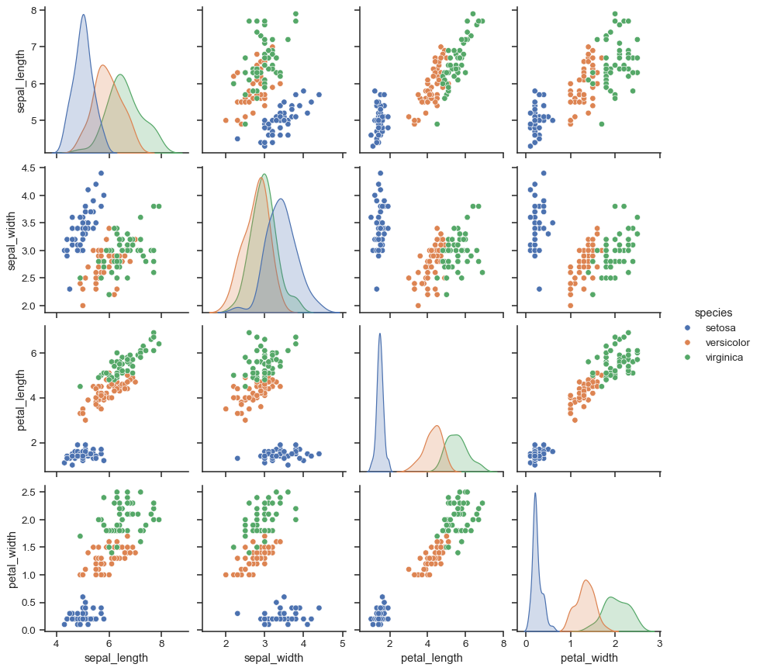
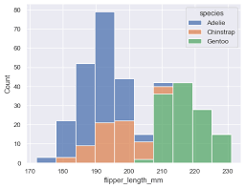
What is Seaborn?
Seaborn is a data visualization library built on top of matplotlib
Designed for creating attractive and informative statistical visualizations in Python
Provides high-level functions for visualizing data patterns, such as distributions, relationships, and trends.
Seaborn is easier and more aesthetic than matplotlib, requiring fewer lines of code for even complex plots.
Functions like sns.countplot(), sns.boxplot(), sns.histplot(), and sns.pairplot() provide valuable insights into the contents of a dataset

Slide 7
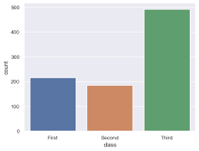
Important Seaborn Functions to Know (pt. 1)
import seaborn as sns
Imports the Seaborn library into your project, so that you can use its member functions when creating your visualizations. The “as” portion of the line is important, as this gives the function an alias that you can refer to
sns.countplot(x, data)
X: name of a categorical variable in data
data: your dataset as named in your project
Creates a frequency chart like this →

Slide 8
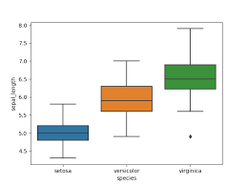
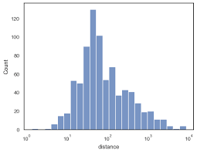
Important Seaborn Functions to Know (pt. 2)
sns.boxplot(x, y, data)
X: name of categorical variable in data (indep. var)
Y: name of continuous variable in data (dep. var)
data: your dataset as named in your project
sns.histplot(data, x)
X: name of a categorical variable in data
data: your dataset as named in your project
Can set further arguments such as “bins”

Slide 9
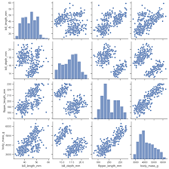
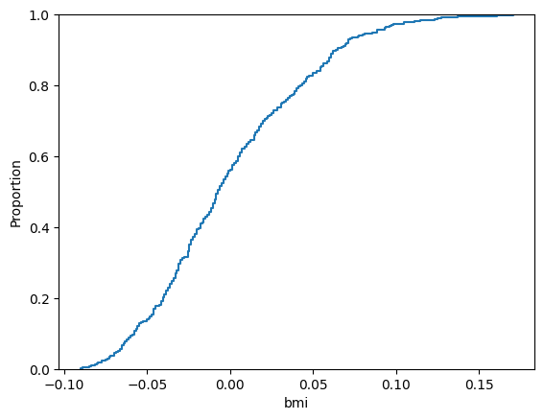
Important Seaborn Functions to Know (pt. 3)
sns.pairplot(data)
data: your dataset as named in your project
This creates a plot for every single numeric column in your dataset. You can specify which you want to be included using the “vars” argument
sns.ecdfplot(data)
data: the feature that you are analyzing (one column)
Creates a distribution of cumulative data points for a specific feature
From the plot to the right, we can determine what proportion of data falls above or below different data values

Slide 10
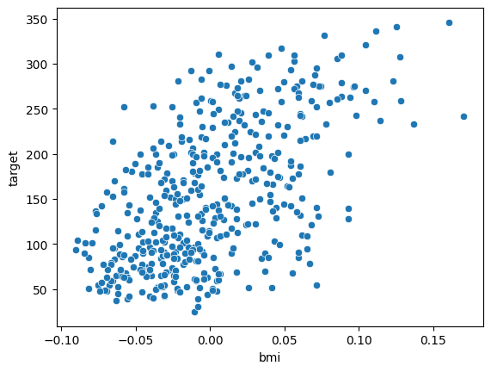
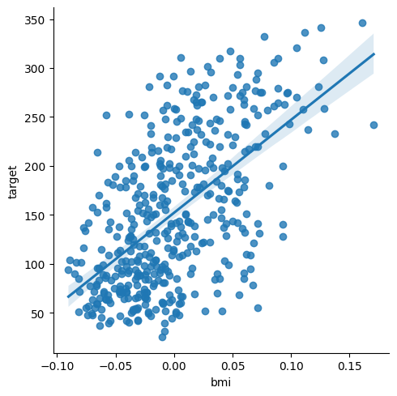
Important Seaborn Functions to Know (pt. 4)
sns.scatterplot(data, x, y)
data: your dataset as named in your project
x: the variable on the x-axis
y: the variable on the y-axis
Creates a scatter plot visualization showing the relationship between the x and y variables
sns.lmplot(data, s)
data: the dataset as named in your project
Similar to the scatterplot, but also displays a regression line that best fits to the data
The shaded region is a confidence interval

Slide 11

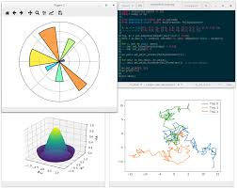
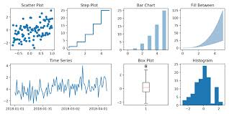
What is matplotlib?
matplotlib is a Python library used to create static, dynamic, and interactive visualizations
Seaborn was built on top of this library!
Lower-level functionality, so Seaborn is typically more viable
Capable of embedding plots into applications (like the one that we’re going to build at the end of the semester)
Remember: Streamlit web app coming soon…
Foundational library for EDA in Python with plenty of functions to better understand your data!

Slide 12
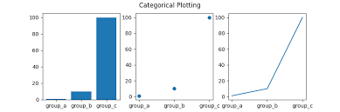
Important matplotlib Functions to Know
import matplotlib.pyplot as plt
Imports the matplotlib library into your project, so that you can use its member functions when creating your visualizations. The “as” portion of the line is important, as this gives the function an alias that you can refer to
plt.plot(x, y)
X: technically optional, independent variable
Y: required dependent variable
(note: if X isn’t given, X = [0:N-1])
Highly customizable way to plot data
Based on datatypes of X and Y

Slide 13
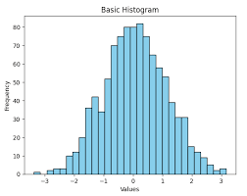
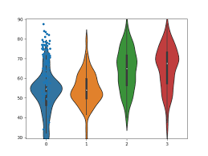
Important matplotlib Functions to Know (pt. 2)
plt.hist(x)
X: input data for independent variable (one col)
Density: defaults to false; creates density histogram
bartype: controls what type of histogram is made
defaults to bar, like one shown
plt.violinplot(x)
X: input data for independent variable (one column)
orientation: optional parameter; defaults to true (vertical), false sets horizontal orientation
Creates a wonderful-looking violin plot of data!

Slide 14
03
Drawing Meaning from Visualizations
Why should we care about having eye-catching visualizations, and how does this aid model interpretability?

Slide 15


How Visualizations Aid Interpretability
In industry, data scientists and statisticians must be capable of fluently communicating complex findings to those who do not have as strong of a background in those fields
E.g. doctors, physicians, healthcare executives in the healthcare industry
Having easy-to-digest visual aids to demonstrate the findings that you may find intuitive can make all the difference in making sure that the people who will use your model can understand it fully!!
Don’t assume anyone outside of your team will know what you know

Slide 16


How Visualizations Aid Interpretability
Visualizations can also be crucial in supplementing our process of developing a machine learning model.
Crucial part of the EDA process
Detect patterns visually, not just numerically
Helps you explain your process/code to other data scientists!
Leads directly into the next step of our process - Feature Engineering and Model Development
Isolate what variables are important
Chart plots relating two features
Choose what to train your model on

Slide 17
04
Brief Overview of PCA and its Uses
What is Principal Component Analysis, what does it tell us about a dataset, and how can it help us with visualizing our data?

Slide 18
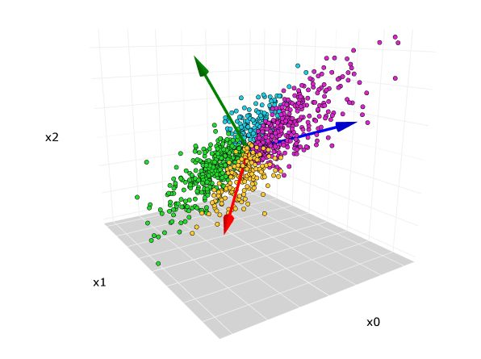
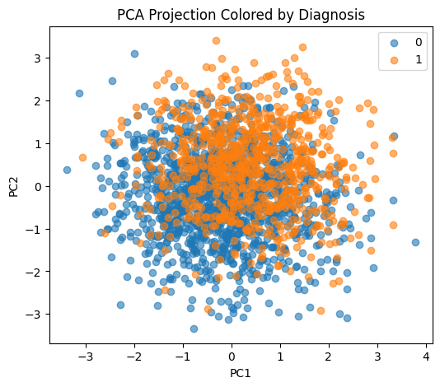
What is Principal Component Analysis?
Linear Algebra technique mainly used for reducing dataset dimensionality while retaining as much information as possible (minimizing loss).
Don’t worry, you do not need to have taken LinAlg to understand or code PCA in Python!
When we have multi-dimensional data, we can use PCA to plot it in a way we can visualize
Ex. dataset with m patients and n=4 features. With PCA, we can plot this in 3D/2D while maintaining most of the information about the relative distance between points.

Slide 19
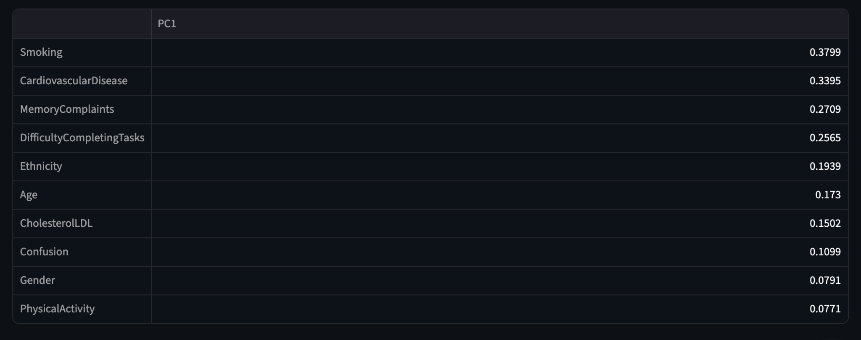
What Can We Get from It?
PCA gives us the principal components of a dataset, which is a linear combination of each of the features passed in.
Lower-number PC = better explainer of variance in the dataset
Looking at the first few PCs shows us which combinations of factors, when observed TOGETHER, provide the greatest indicators for the target.
Plot in top right shows Alzheimer’s dataset on two PCs, stratified by diagnosis (0, 1). Note the minor separation of the clouds!

Slide 20
05
References
Here are a handful of useful guides to high-utility functions, Git demos, and Colab explanations!

Slide 21
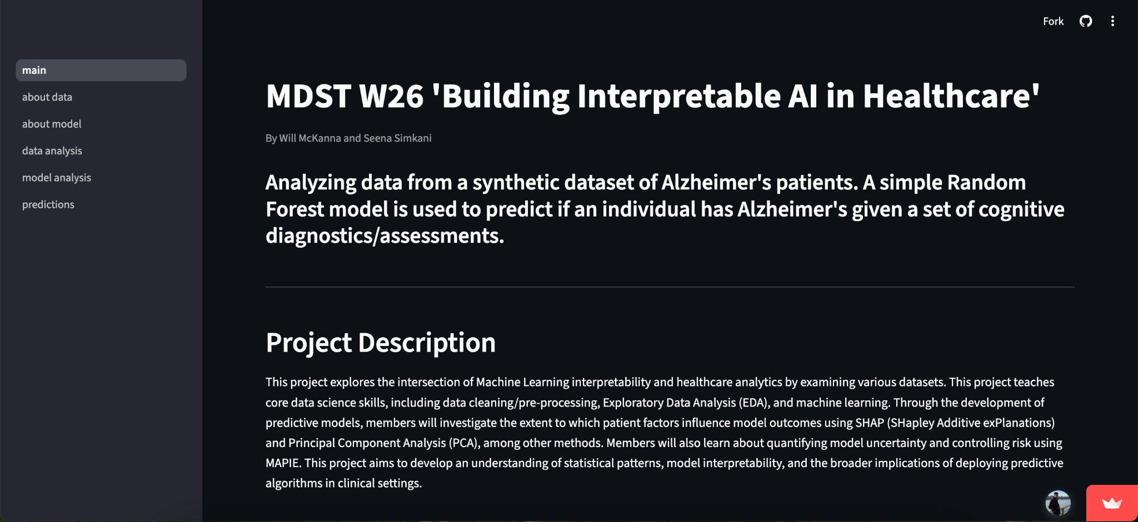
Our Demo! (for reference)
Link: https://mdst-ai-in-healthcare.streamlit.app/

Slide 22





Project Timeline
Week 1 (01/25): Icebreaker/EDA intro, choosing a good dataset
Week 5 (02/22): Conformal Predictions, Risk Control, and Multi-Class Calibration
Week 2 (02/01): Data Visualization, Further EDA
NO MEETING 03/01 OR 03/08 – SPRING BREAK
Week 6 (03/15): SHAP Values and Feature Importance Interpretation
Week 3 (02/08): Feature Engineering and Intro to Machine Learning
Week 7 (03/22): Intro to Streamlit and Project Work Time
Week 4 (02/15): Machine Learning and Model Optimization
Weeks 8 + 9 (03/29 + 04/05): Final Project work time + Data Science Night prep!

Slide 23
Important Functions to Know (pt. 1)
Syntax | Description
import pandas as pd | Import the pandas library, using the alias pd for convenience
import numpy as np | Import the NumPy library, using alias np for numerical operations
import seaborn as sns | Import Seaborn for statistical data visualization
df = pd.read_csv(‘file.csv’) | Load a CSV file into a pandas DataFrame for data manipulation
df.head() | Returns the first 5 rows of the DataFrame, useful for quickly inspecting data
df.info() | Provides a concise summary of the DataFrame, including data types and non-null values

Slide 24
Important Functions to Know (pt. 2)
Syntax | Description
df.describe() | Generates descriptive statistics of numerical columns (mean, median, quartiles, etc.)
df[‘column_name’] | Access a specific column in the DataFrame, works like a key in a dictionary
df.drop(columns=[‘col’...]) | Drops specified columns from the DataFrame,use inplace=True to modify the original DataFrame
df.index | Returns the index labels of the DataFrame
df.isnull() | returns a DataFrame of boolean values, where each entry indicates whether the corresponding value in df is NaN (missing)

Slide 25
Important Functions to Know (pt. 3)
Syntax | Description
df[‘column’].value_counts() | Returns the count of unique values in a specific column
df[‘column’].mean() | Returns the mean value of a numerical column
df.corr() | Computes correlation for numerical columns to understand relationships
df.columns | Lists all column names in the DataFrame, useful for renaming or viewing dataset structure
df.shape | Returns # of rows and columns

Slide 26
Important Functions to Know (pt. 4)
Syntax | Description
df.rename(columns={'old': 'new'}, inplace=True) | Renames specific columns to new names
df.groupby(‘category’)[‘value’] | Groups the DataFrame using a specified column to perform aggregate functions (e.g., .sum(), .mean())
df[‘new_column’] = df[‘column’].apply(function) | Applies a function to each element or column/row
df.shape | Returns a tuple representing the dimensions (rows, columns) of the DataFrame
df.dropna() | Removes rows or columns containing missing values

Slide 27
Important Functions to Know (pt. 5)
Syntax | Description
df.to_numpy() | Converts Pandas DataFrame into a NumPy array
np.shape | Returns a tuple representing the dimensions (rows, columns) of the array (similar to df.shape)
np.reshape() | Reshapes an original numpy array to the specified dimensions (rows, columns)
np.array() | Creates an N-dimensional array (ndarray) which is more memory efficient than standard python lists
np.unique() | Returns the unique elements in a NumPy array (also returns the counts of each element given the keyword argument, return_counts=True)

Slide 28
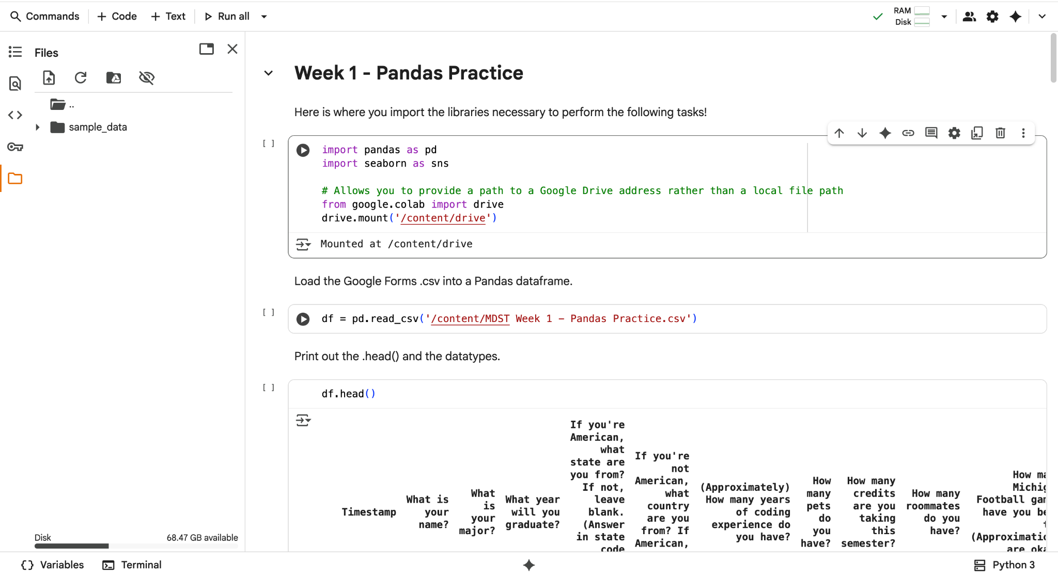
How to Upload Files into Colab
Click on the folder in the sidebar

Slide 29
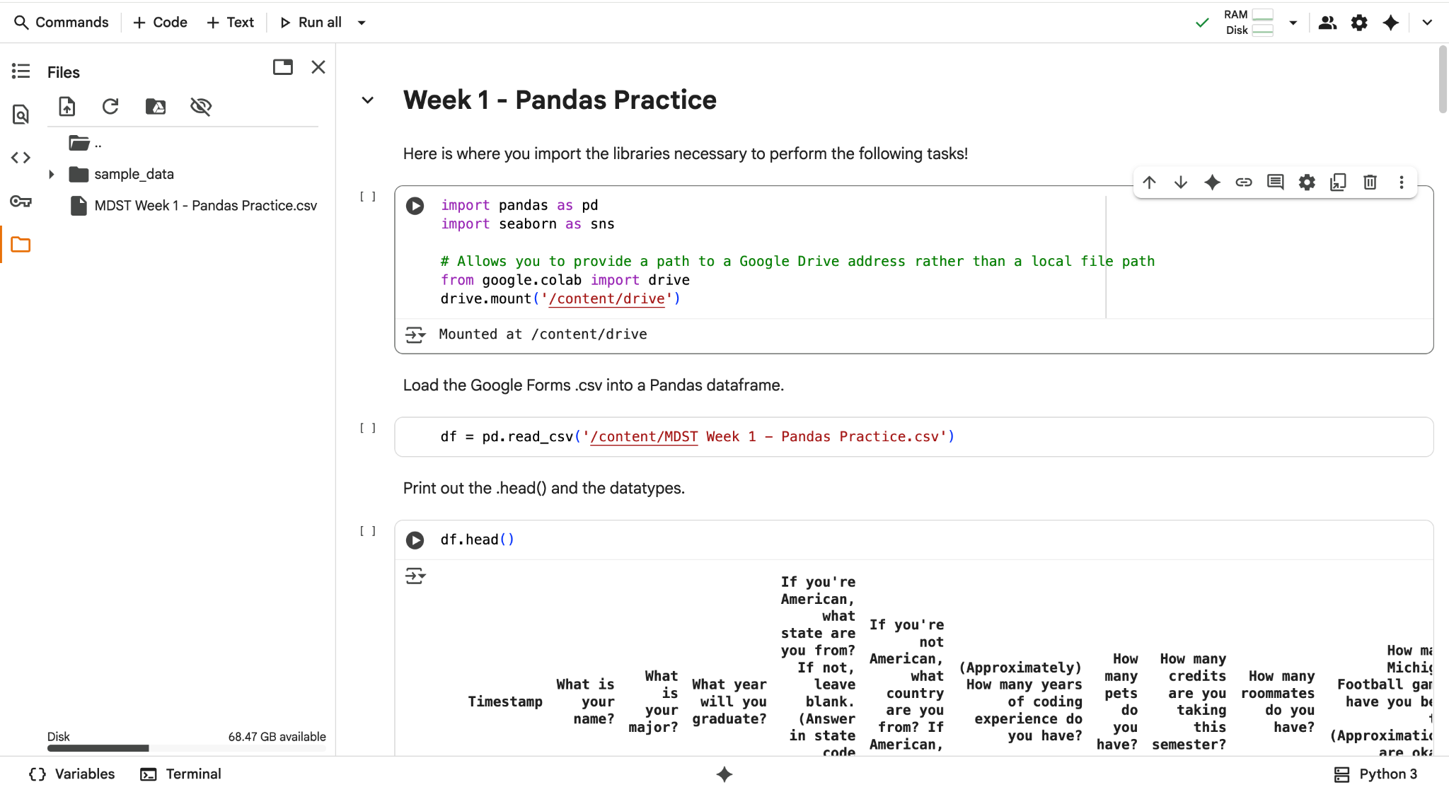
How to Upload Files into Colab
Click the upload button and select the file you want to upload

Slide 30
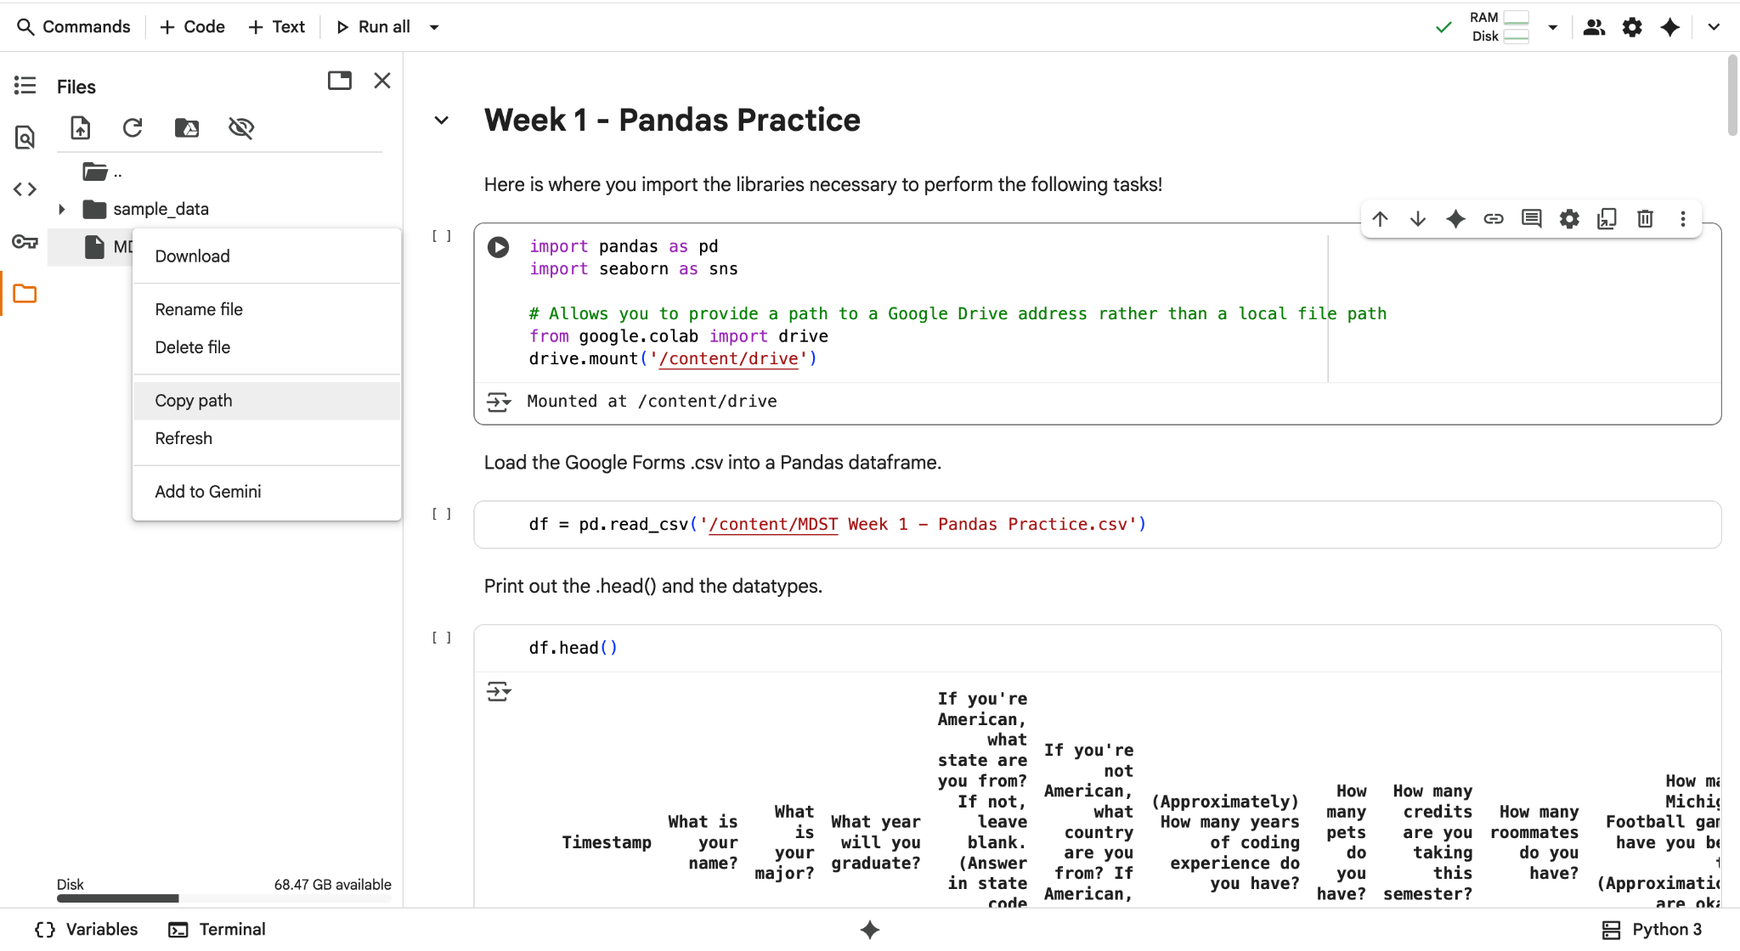
How to Upload Files into Colab
Click the three dots and copy the path. Put this in your read function

Slide 31
How to Mount Your Google Drive
from google.colab import drive
drive.mount('/content/drive')
pd.read_csv(‘/content/drive/MyDrive/[FILE NAME]’)
**NOTE: If you saved your dataset in a folder (not just loose in your MyDrive folder), you will need to add further code to the file path before the file name in the final line. For example, if I saved my data called “alzheimers.csv” in a folder called “MDST-W26,” my read_csv statement would read:
pd.read_csv(‘/content/drive/MyDrive/MDST-W26/alzheimers.csv’)

Slide 32
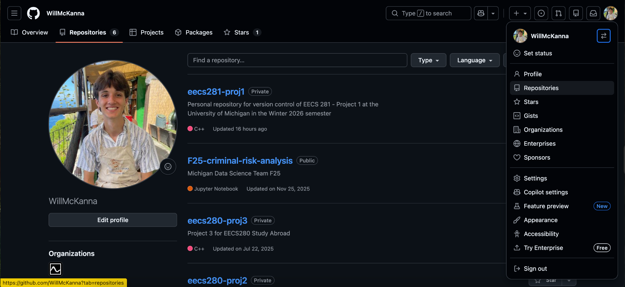
How to Create a GitHub Repository (yay for version control!)
Navigate to GitHub, click your profile picture, and select “Repositories.” Then, click the green “New” button next to the “Language” dropdown menu

Slide 33
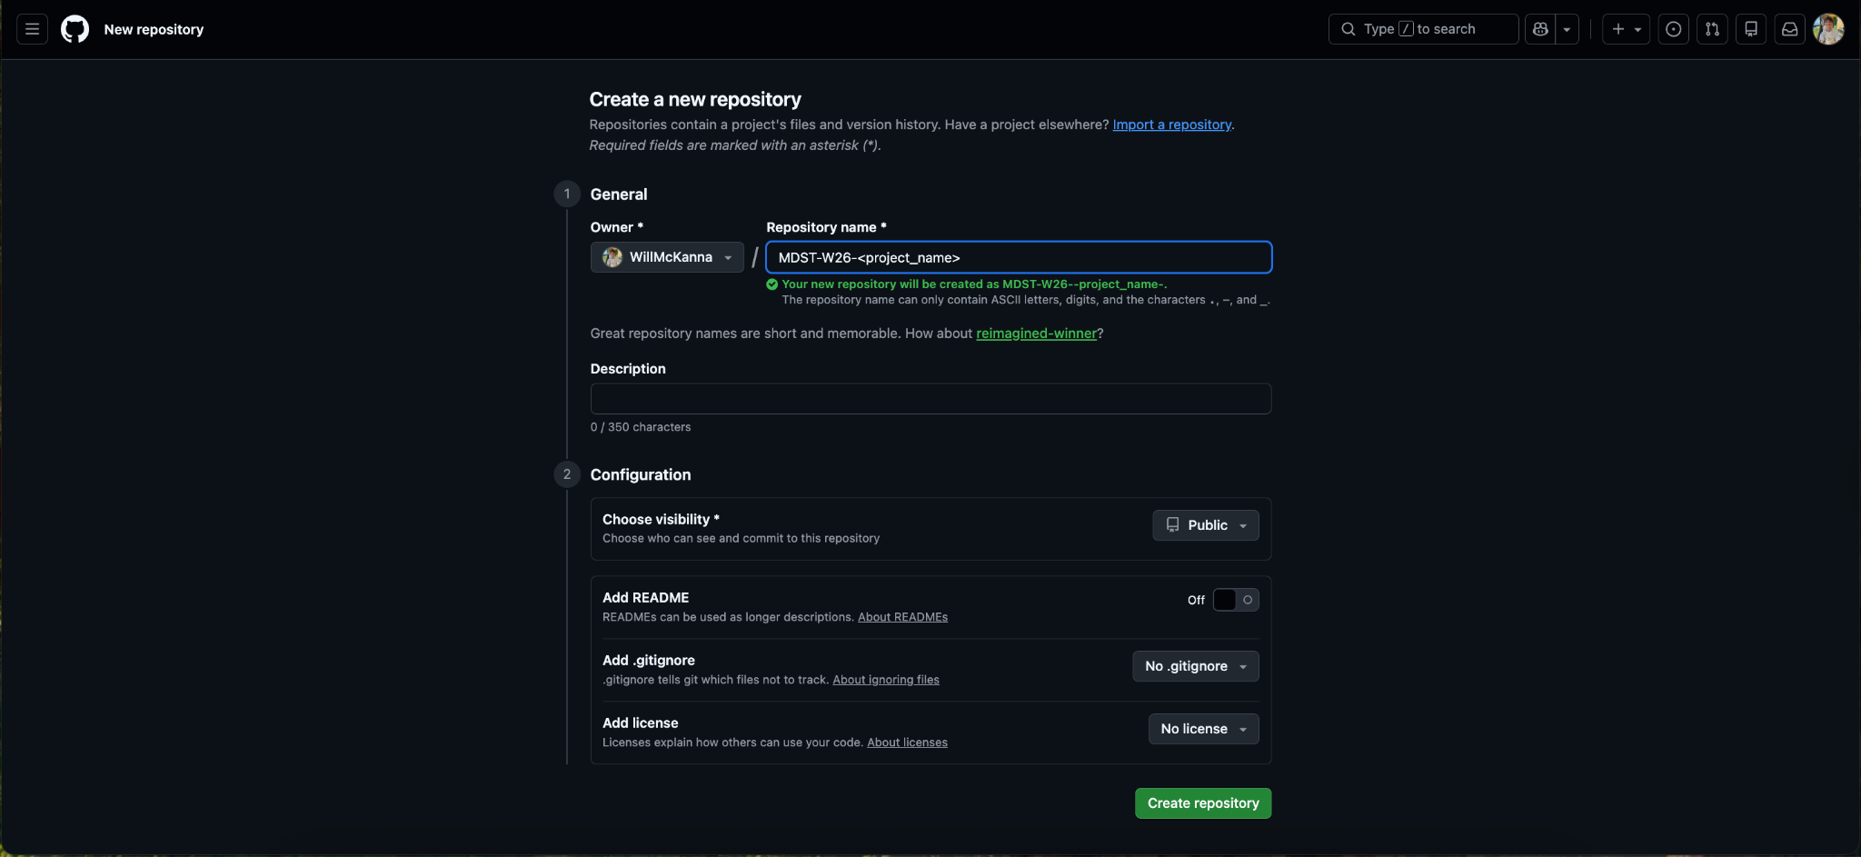
How to Create a GitHub Repository (yay for version control!)
2. Name your repository something memorable, then click “Create Repository”

Slide 34
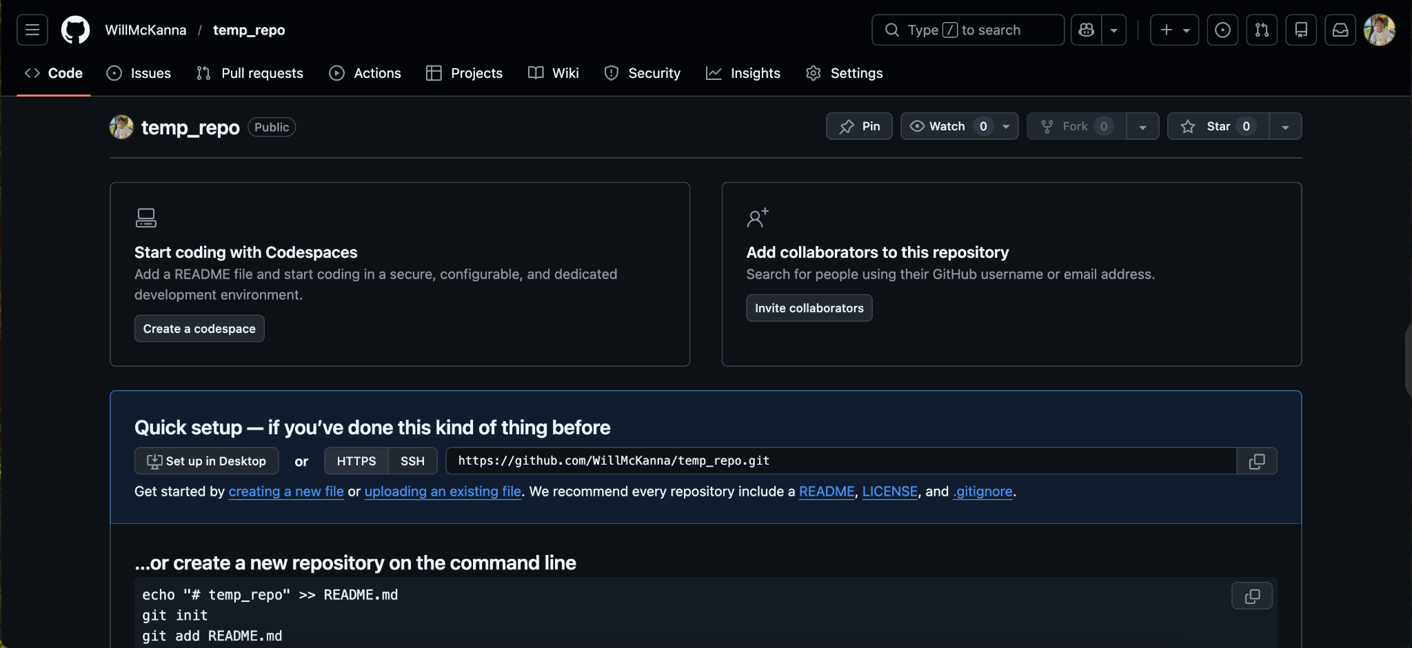
How to Create a GitHub Repository (yay for version control!)
3. Then, populate your repo either with your files, OR click “creating a new file”

Slide 35
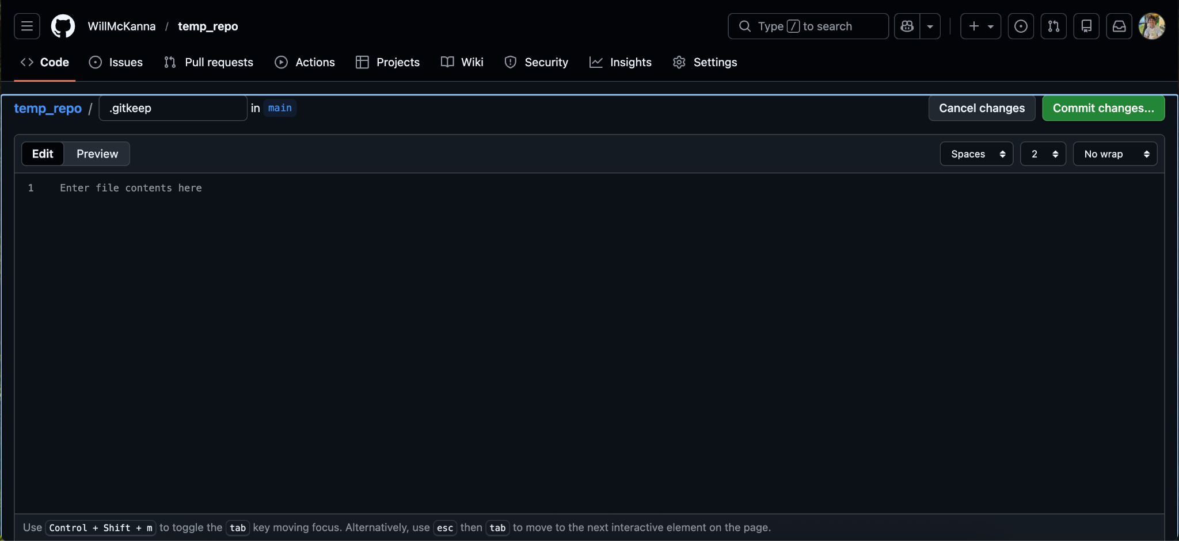
How to Create a GitHub Repository (yay for version control!)
3(b). If you click “create a new file,” entitle it “.gitkeep” and click “Commit changes”

Slide 36
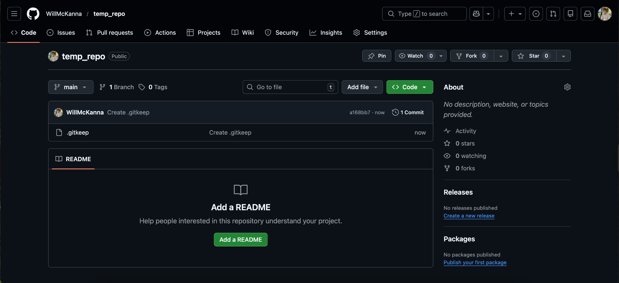
How to Create a GitHub Repository (yay for version control!)
4. Your repo is made! Continue adding to it by clicking the “Add file” dropdown menu

